Slide 1
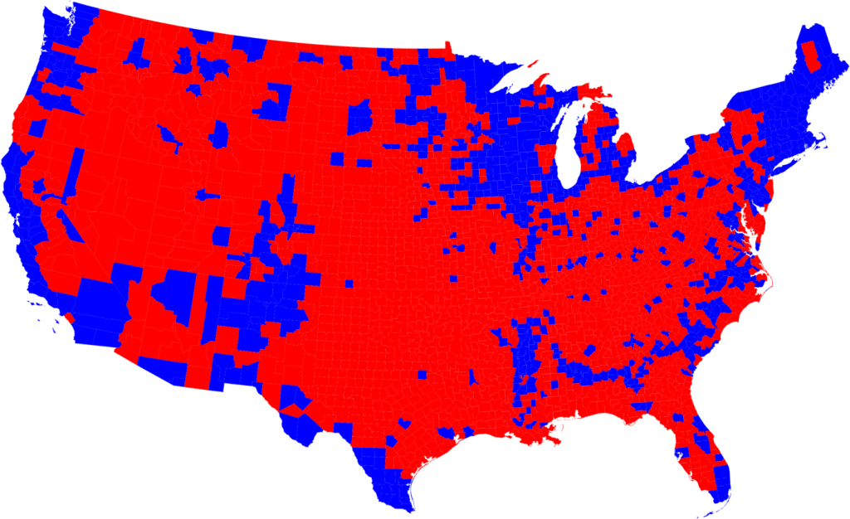
USA STATISTICS
Group 03:
Jayalakshmi Vaidyanathan
Krutika Ambavane
Neha Narayankar
This Photo by Unknown Author is licensed under CC BY

Slide 2
Dataset On USA Statistics
The dataset is composed of homeowners financial, family and population related information from 2012-2016
Important coulmns in the dataset are :
hi_mean: Household Income
debt: Percentage of home with some type of debt
rent_mean: The mean gross rent of the specified graphic location
type: The place type reported by the U.S. Census Bureau for the specified geographic location

Slide 3
Data Cleansing
Dropped unnecessary and redundant columns
Handled NaN values
Converted all the columns to lower case
Used the binning concept
Adjusted the precision of the values

Slide 4
Questions To Analyze
How is the rent variation across entire United States?
What are the factors that affect the rent prices?
What kind of people prefer higher rent?
How are income, rent and debt related?
What do people do to handle their debts?

Slide 5
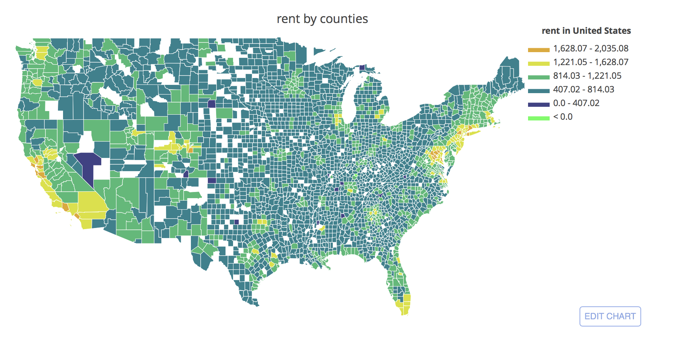
US Rent Distribution

Slide 6
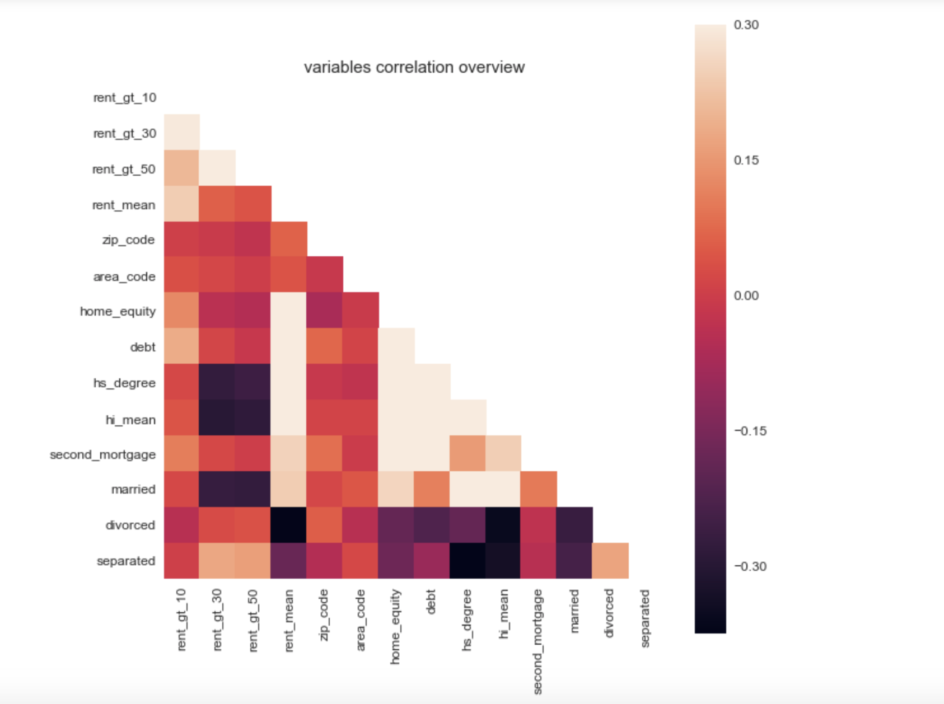
Heatmap : Variable Correlation

Slide 7
Jupyter Notebook

